Slide 1

Dennis dsouza
Final Project
3/21/2024 Annual Review

Slide 2

Project tittle: I-Enhanced Comic Book Creator
3/21/2024 Annual Review

Slide 3


AGENDA
Phase 1: Research and Planning
Phase 2: Design
Algorithm Design:.
Phase 3: Development
Phase 4: Testing
Unit Testing:
Integration Testing:
User Testing:
Phase 5: Deployment
3/21/2024 Annual Review

Slide 4

PROBLEM STATEMENT Ethical implications: How does the use of I-Enhanced Comic Book Creator technology affect the boundaries between creativity and artificial enhancement? Are there concerns about authenticity and integrity in storytelling? Social impact: What are the consequences of widespread access to technology that allows individuals to create highly realistic and immersive comic book experiences? How does this impact traditional forms of storytelling and the broader cultural landscape? Personal struggles: How do the characters grapple with the temptation to rely on technology to enhance their creative abilities versus the desire to cultivate their skills through traditional means? What internal conflicts arise as they confront the limitations and risks of using the I-Enhanced Comic Book Creator?
3/21/2024 Annual Review

Slide 5

PROJECT OVERVIEW
Technology Overview: Viewers are introduced to the I-Enhanced Comic Book Creator, a sophisticated platform that combines artificial intelligence, augmented reality, and other advanced technologies to empower users to create highly immersive and visually stunning comic book experiences.
Creative Possibilities: The show explores the limitless creative possibilities unlocked by the I-Enhanced Comic Book Creator, showcasing how users can effortlessly bring their ideas to life through dynamic artwork, interactive storytelling elements, and innovative narrative techniques.
Cultural Impact: As the use of the I-Enhanced Comic Book Creator becomes widespread, the show examines its impact on the cultural landscape, from transforming the comic book industry to influencing other forms of media and entertainment.
Ethical and Social Considerations: Alongside its technological advancements, the show also addresses the ethical and social implications of using the I-Enhanced Comic Book Creator. It raises questions about authenticity, artistic integrity, privacy concerns, and the potential for misuse or abuse of the technology.
Personal Stories: Through the experiences of diverse characters, the show explores the personal journeys, struggles, and triumphs of individuals who use the I-Enhanced Comic Book Creator, highlighting the ways in which technology intersects with their lives and identities.
3/21/2024 Annual Review

Slide 6

WHO ARE E END USERS? 1:comic book artists and writer 2:graphic designers 3:comic book enthusiasts 4:educator and students 5:entertainment industry professionals
3/21/2024 Annual Review

Slide 7

YOUR SOLUTION AND ITS VALUE PROPOSITION adavaced digital tools:The I-Enhanced Comic Book Creator offers a comprehensive suite of advanced digital tools tailored specifically for comic book creation. From intuitive drawing and painting features to powerful editing and layout tools, creators can easily bring their ideas to life with precision and creativity. Artificial Intelligence Integration: Leveraging cutting-edge artificial intelligence technology, the platform provides users with intelligent assistance throughout the creative process. AI algorithms can assist with tasks such as character design, background generation, and even dialogue suggestions, saving time and enhancing the quality of the final product. Immersive Storytelling Capabilities: With support for 3D modeling, animation, and interactive elements, the I-Enhanced Comic Book Creator allows creators to craft immersive storytelling experiences that captivate readers. Dynamic panel layouts, parallax effects, and augmented reality features transport readers into the heart of the story, enhancing engagement and enjoyment. Streamlined Workflow: By integrating all aspects of comic book creation into a single platform, the I-Enhanced Comic Book Creator streamlines the workflow for creators. From initial concept development to final publication, users can seamlessly navigate each stage of the process, reducing inefficiencies and maximizing productivity. Collaboration and Community Building: The platform fosters a vibrant community of comic book creators, providing opportunities for collaboration, feedback, and networking. Users can share their work, collaborate on projects, and connect with fellow creators
3/21/2024 Annual Review

Slide 8

THE WOW IN YOUR SOLUTION 1:AI-Powered Creativity: Imagine having an AI collaborator that helps you flesh out characters, generate background settings, and even suggests plot twists. This isn't just a drawing tool; it's a creative partner that enhances your ideas and pushes your storytelling to new heights. 2:Dynamic Storytelling: Static panels are a thing of the past. With our platform, creators can animate scenes, add interactive elements, and even integrate augmented reality components. Readers aren't just flipping pages; they're stepping into the world you've crafted, experiencing the story in ways they never imagined. 3:Community Collaboration: Connect with fellow creators, collaborate on projects, and get instant feedback from a global community of comic book enthusiasts. The platform isn't just about making comics; it's about building relationships, fostering creativity, and pushing the boundaries of what's possible together. 4:Streamlined Workflow: Say goodbye to juggling multiple software programs and endless revisions. Our all-in-one platform streamlines the entire comic book creation process, from sketching to publication. With intuitive tools and seamless integration, you can focus on what you do best: telling amazing stories. 5:Accessibility for All: Whether you're a seasoned professional or a first-time creator, our platform is designed to be intuitive and user-friendly.
3/21/2024 Annual Review
8

Slide 9

MODELLING
Teams cam add wireframes
Character Modeling: Creators can sculpt and design intricate characters using advanced modeling tools. From superheroes with dynamic poses to intricate villains with unique features, our platform allows for the creation of diverse and visually captivating characters that leap off the page.
Environment Modeling: Whether it's bustling cityscapes, lush jungles, or otherworldly landscapes, our platform enables creators to build immersive environments with precision and detail. Using a combination of sculpting, texturing, and terrain generation tools, creators can craft richly detailed settings that serve as the backdrop for their stories.
Prop Modeling: From high-tech gadgets to ancient artifacts, our platform provides tools for modeling a wide range of props and objects. Creators can design custom props that add depth and authenticity to their stories, whether they're essential plot devices or simply background elements that enhance the scene.
Integration with 2D Artwork: Our platform seamlessly integrates 3D models with 2D artwork, allowing creators to blend traditional hand-drawn elements with digitally sculpted models. This integration enhances the visual appeal of the comic book and provides flexibility in how creators approach the visual storytelling process.
3/21/2024 Annual Review
9

Slide 10
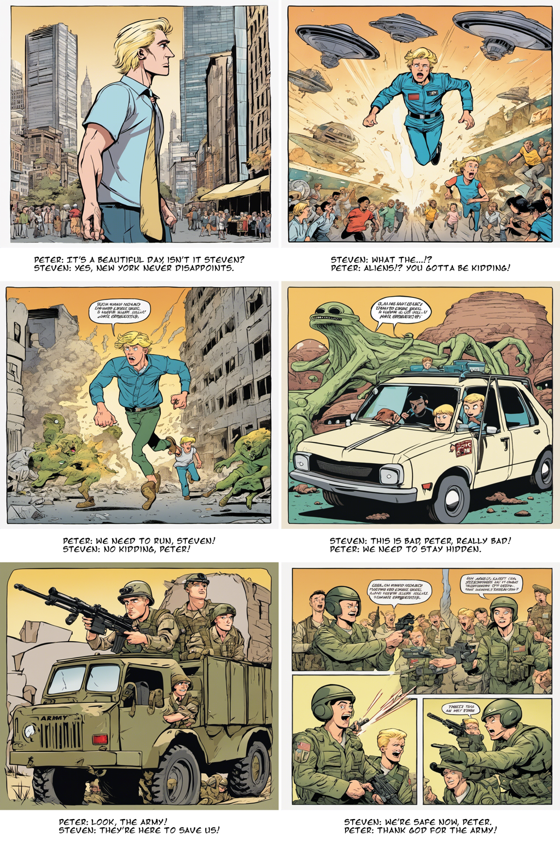
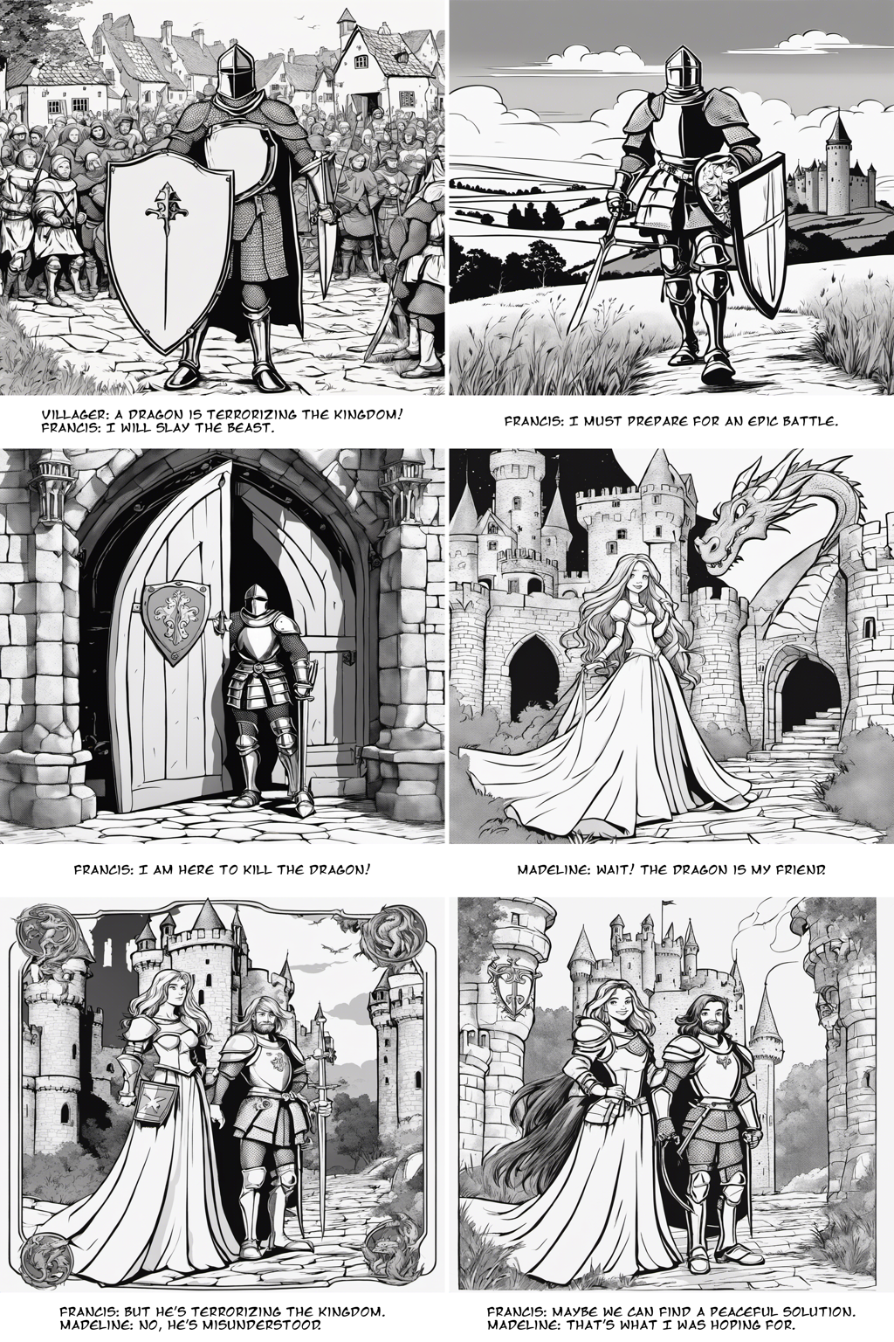
Result
Demo Link
3/21/2024 Annual Review
10

